Slide 1
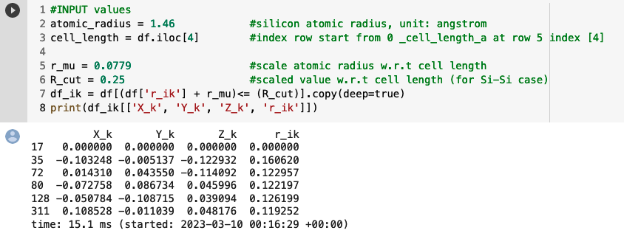
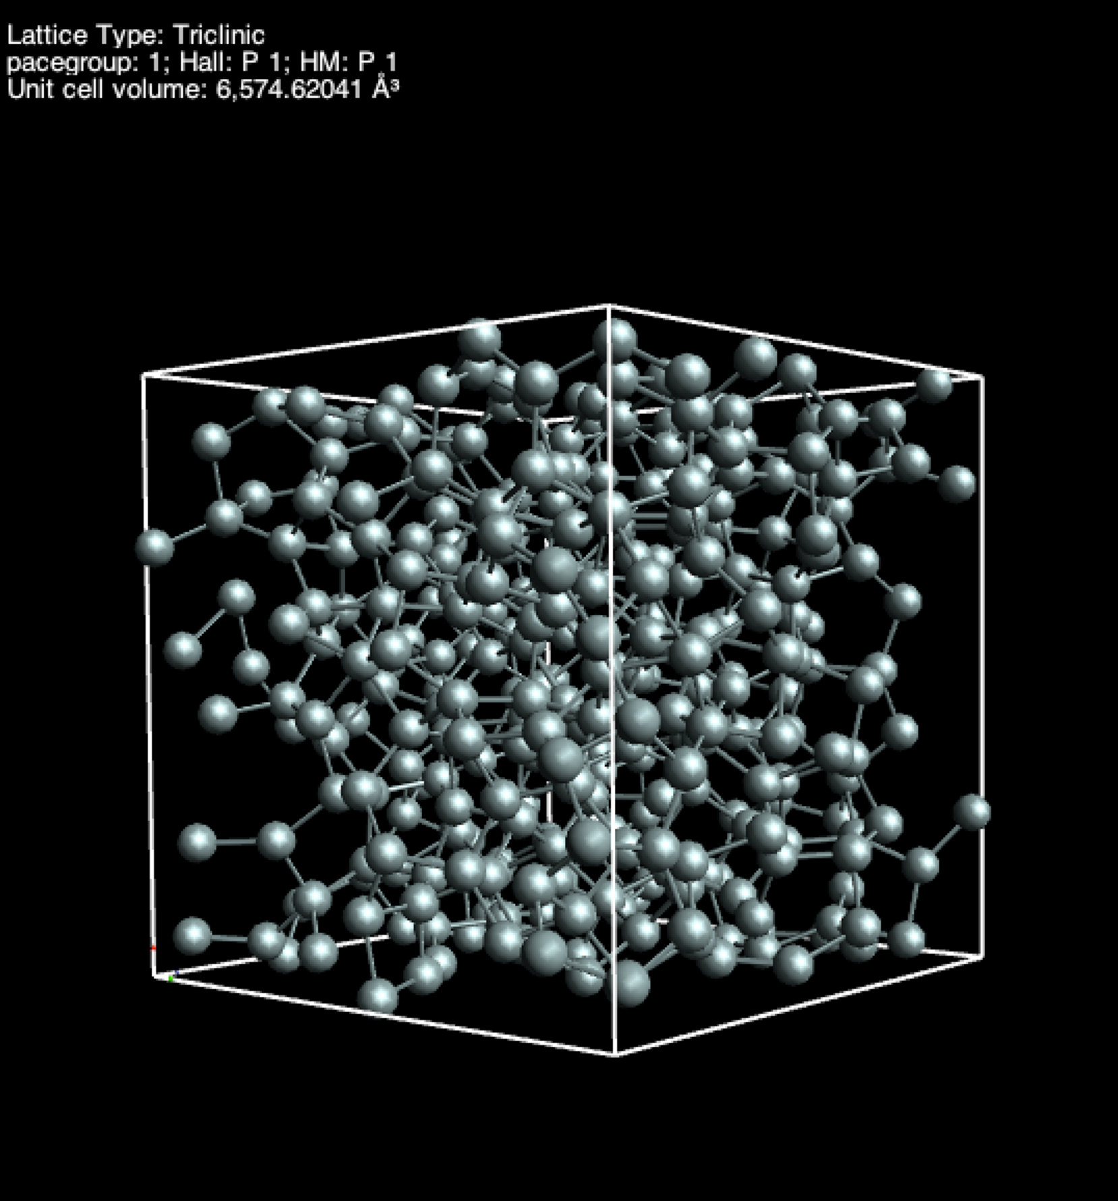
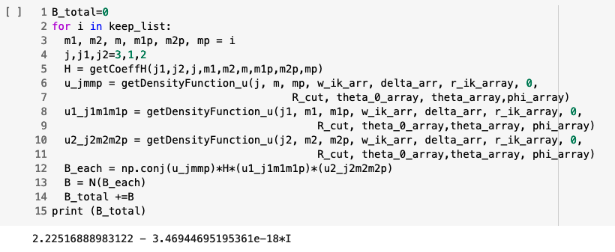
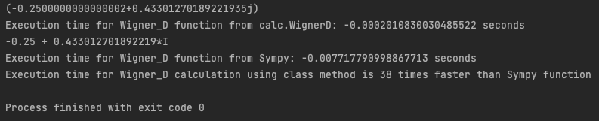








Optimizing Python Code for Bispectrum Components
as Descriptors in Machine Learning Models
Duong Hoang
Faculty of Physics & Astronomy, University of Missouri – Kansas City
Introduction
Generate bispectrum components
Calculate
Potential
Results
Machine learning and computational physics have transformed materials science by providing powerful tools to accelerate the discovery and development of new materials. Accurately predicting electronic structure is essential for designing materials with desired properties. While Density Functional Theory (DFT) is a popular computational model, it faces challenges when dealing with transition metals, rare earth elements, and strong correlation effects. Therefore, current research aims to improve DFT's accuracy and applicability by developing new functionals and techniques.
Objective: This research aims to develop a new machine learning framework and additional descriptors such as bispectrum components, Coulomb matrix eigenvalues (CMEs), and Atom-centered Symmetry Functions (ACSFs) to enhance the accuracy and applicability of predicting electronic structure. This research poster presents our work on computing bispectrum components using Python scripts and using them as input features for a machine learning model.
Significance: Predicting electronic structure enhances our understanding of the correlation between atomic structure and local environment, which can facilitate the development of advanced materials and new technologies. Bispectrum components are a promising descriptor for capturing essential features of electronic structure that traditional spectral descriptors may miss.
Measure of Success: The success of this project will be the development of Python scripts that can automatically generate bispectrum coefficients from crystal structure datasets, and the accuracy of the calculations will be tested by comparing predicted electronic structure results to theoretical results.
Important: Predicting electronic structure is crucial in understanding and optimizing the properties of materials. The arrangement of electrons in atoms and molecules determines various physical and chemical properties, including bonding, conductivity, and mechanical properties. A comprehensive understanding of electronic structure is vital for developing new materials with superior properties and improving the performance of existing materials. Accurate prediction of electronic structure can facilitate the design of advanced materials for various applications and contribute to the invention of new technologies that benefit society.
Python script
Data processing
model structure
We were able to compute the bispectrum component for the selected central atom. However, the computation time took approximately 46 minutes, which is not efficient enough for testing symmetry by interchanging j1, j2, and j values, especially for larger systems with more atoms.
Error correction
Predict electronic structure of the materials
Predict
potential
Neural Network
Systems
Examining model
Unit cell of Amorphous Silicon
Number of atom in the cell: 340
Cell length (a,b,c) = (18.7337, 18.7337, 18.7337_
Cell angle (𝛂, 𝛽, 𝞬) = (90,90,90)
Atom site type : Si
Atoms x,y,z site fraction
Data preparation
Read CIF file avgBL-Model.cif
Cell length (unit angstrom)
Define cut off radius
Project the atomic density onto the surface of four- dimensional unit sphere
Note: Chosen radius cut off needs to divide by the true cell length (i.e: with example dataset we need to divide by 18.7337) since (x,y,z) are fraction with cell dimension (1,1,1)
Define position neighbors atom k relative to a central atom i is a point within the 3D ball of radius
Project the atom (x,y,z) location onto the surface of four- dimensional unit sphere
Background
Electronic Structure Prediction: A Brief Review of Machine Learning's State-of-the-Art Techniques
Method of Kohn- Sham (KS) DFT
Standard for the first principles calculation of electronic structure
Constructed using the physical conditions, such as asymptotic behavior and scaling relations
Challenges:
The computational expense of applying these methods to large systems remains a significant challenge.
Precise experimental observation of electronic density is difficult
→limited availability of the training dataset
→need to employ theoretical calculations for generating the training data
New Python scripts have been developed to calculate Clebsch-Gordan coefficients and Wigner-D functions, with optimized running times that do not require the use of third-party libraries such as SymPy. Our custom Wigner-D function exhibits faster running times than SymPy's implementation, while the running times for Clebsch-Gordan coefficients show no significant differences.
Figure 3: Unit cell of a morphic silicon, Avogradro visualization
initial guess for exchange-correlation (xc) potential Vxc[n] ≣ functional of density
INPUT
DATA
NEURAL NETWORKS
OUTPUT
Density function
Methods
Future Work
Compute Bispectrum Component
Code optimization: Bispectrum Class Function
Propose new Machine Learning framework
Compute other descriptors for input training:
Atom-centered Symmetry Functions (ACSFs): descriptor of the local environment of each atom, these models can capture the complex relationships between the atomic positions and the electronic structure of the molecule, leading to accurate predictions of electronic properties.
Coulomb matrix eigenvalues (CMEs)
Bag of bond
Input data
Define parameters input:
radius cutoff
neighbors list
atom type
weight coefficient
Clebsch- Gordan Coefficient
Figure 2: Summarize ML- KS DFT framework
Improvement
Efficient way to train the ML model: semilocal form trained with accurate electronic density data in a few molecules can yield practical accuracy for various molecules → seek out descriptors that describe local atomic environment.
2. Recent study: Materials Learning Algorithms - MALA [13]
Generate models of density functional theory calculations based on machine learning.
Pros:
Reproduction of the functionality of DFT calculations to a large extent by providing direct access to the electronic structure of materials.
High accuracy even at ultra-large scales of up to 10000 of atoms.
Low computational cost compared to traditional DFT calculations: MALA grows linearly with the number of atoms, meanwhile DFT (~ ) do not scale linearly with the size of the data set
The potential to replace machine learning interatomic potentials and yield thermodynamic observables at much higher accuracy.
References
Rotational Matrix U via Wigner D function
[1]Thompson, A. P., Swiler, L. P., Trott, C. R., Foiles, S. M., & Tucker, G. J. (2015). Spectral neighbor analysis method for automated generation of quantum-accurate interatomic potentials. https://www.osti.gov/biblio/1426894
[2]Mason, J. K. (2009). The relationship of the hyperspherical harmonics to SO(3), SO(4) and orientation distribution functions. Acta Crystallographica Section A, 65(3), 259. https://libraryh3lp.com/file/8j46b06z956ega%40web.libraryh3lp.com/1665598079.pdf?t=6sfhoB1XgCcztCUZBmTEDs
[3]Bartók, A., Payne, M. C., Risi, K., & Csányi, G. (2010). Gaussian approximation potentials: The accuracy of quantum mechanics, without the electrons. https://arxiv.org/pdf/0910.1019.pdf
[4]Meremianin, A. V. (2006). Multipole expansions in four-dimensional hyperspherical harmonics. Journal of Physics A: Mathematical and General, 39(12), 3099. https://iopscience.iop.org/article/10.1088/0305-4470/39/12/017/pdf?casa_token=YfzEUY2g4jwAAAAA:bqMuUwTRpQXDQEpCSvvwmlFYX6hi0xis-vCqLThjemvfDObHjP7XZw28oexUMra9FGg7AV1FVKvhtzZJn28g
[5]Varshalovich, D. A., Moskalev, A. N., & Khersonskii, V. K. (1988). Quantum theory of angular momentum. https://library.oapen.org/handle/20.500.12657/50493
[6]Cusentino, M. A., Wood, M. A., & Thompson, A. P. (2020). Explicit Multi-element Extension of the Spectral Neighbor Analysis Potential for Chemically Complex Systems. Journal of Physical Chemistry A, 124(26), 5456–5464. https://doi.org/10.1021/acs.jpca.0c02450
[7]LAMMPS. (n.d.). Compute sna/atom command. Retrieved from https://docs.lammps.org/compute_sna_atom.html
[8] Li, Z., Raabe, D., Gault, B., Zhang, Z., Tasan, C. C., & Springer, H. (2020). Complex strengthening mechanisms in the NbMoTaW multi-principal element alloy. Scientific reports, 10(1), 1-11. https://doi.org/10.1038/s41524-020-0339-0
[9]Shi, Y., Totton, T. S., Zhang, Y., & Gao, H. (2020). Neural network potential from bispectrum components: A case study on crystalline silicon. The Journal of Chemical Physics, 153(5), 054118. https://doi.org/10.1063/5.0014677
[10]Zuo, Y., Chen, C., Li, X., Deng, Z., Chen, Y., Behler, J., Csányi, G., Shapeev, A. V., Thompson, A. P., Wood, M. A., & Ong, S. P. (2020). Performance and Cost Assessment of Machine Learning Interatomic Potentials. Journal of Physical Chemistry A, 124(4), 731-745. https://doi.org/10.1021/acs.jpca.9b08723.
[11] Yanxon, H., Tothadi, S., de Jong, W. A., Wolverton, C., & Persson, K. A. (2021). PyXtal_FF: a Python library for automated force field generation. Machine Learning: Science and Technology, 2(2), 027001. doi: 10.1088/2632-2153/abc940
[12]Biedenharn, L. C., & Louck, J. D. (1984). Angular momentum in quantum physics. Cambridge University Press. ISBN: 978-0521302289.
[13]Fiedler, L., Modine, N., Schmerler, S., Vogel, D. J., Popoola, G. A., Thompson, A., & Rajamanickam, S. (2022, October 20). Predicting the Electronic Structure of Matter on Ultra-Large Scales. Journal of Chemical Theory and Computation, 18(10), 5891-5905. doi: 10.1021/acs.jctc.2c00830
[14]Nagai, R., Akashi, R., & Sugino, O. (n.d.). Completing density functional theory by machine learning: hidden messages from molecules. Retrieved March 10, 2023, from https://arxiv.org/abs/2102.03119v1
[15] Kulik, H. J., Welborn, M., Marom, N., Tkatchenko, A., Hennig, R. G., Kästner, J., Lilienfeld, O. A. v., & Yang, T. (2022). Roadmap on Machine learning in electronic structure. Electron. Struct., 4, 023004. https://doi.org/10.1088/2516-1075/ac572f
Expansion coefficients density function
3. Bispectrum Component as descriptor
Quantum nearsightedness is a concept that describes the rapid decay of electron correlation with distance in materials. This means that the electron correlation has a stronger effect on nearby atoms compared to distant atoms. To capture this effect, the bispectrum coefficient is used as a descriptor in machine learning models.
Test accuracy
Bispectrum Component
Figure 4: Mathematical Framework for Bispectrum Component Calculation and Testing
Copyright © 2023 UMKC
Work supported Dr. Rulis and Duong Hoang
Contact us at: rulisp@umkc.edu, dtht2d@umsystem.edu

